Slide 1
EFFECTS OF MOTOR TASKS WITH UNSTABLE TOOLS ON STATIC BALANCE AND SPEED WALKING IN OLDER WOMENS
Advancing Motor Development Research in the 21st century
​
October 11-13, 2020
​
Virtual Conference
Italo Sannicandro¹, Giacomo Cofano², Rosa Anna Rosa², Andrea Piccinno³ and Dario Colella¹
¹Clinical and experimental medicine Department, University of Foggia, Italy
²Master’s Degree of Preventive and Adapted Physical Activity, University of Foggia, Italy
³Adapted physical education teacher, Italy
italo.sannicandro@unifg.it

Slide 2
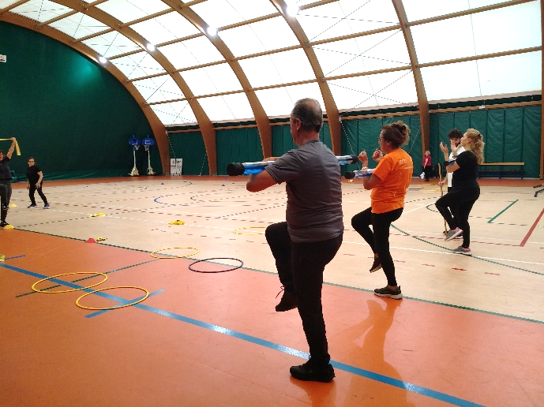
OBJECTIVE The aim of the study is to verify the effects of motor tasks with unstable tools on the static balance ability and on the walking speed in older women
METHODS
A sample of 48 older womens (68,2±2.7 years, 58.9±5.4 kg, 157.5±4.6) participated in the investigation; the sample was divided by randomizing within blocks into 2 groups: n=25 were included in the instability training group (IG) while n= 23 were included in the control group (CG).
The training period lasted 8 weeks, 3 sessions a week for a total of 24 sessions of about 50 minutes each. The tool used in the motor tasks was a plastic cylinder with water weighing about 4.8 kg (Slashpipe, Slashpipe GmbH, Essen, Germany).
The following functional tests were used to evaluate motor capacity: Single Leg Stance Test (SLST) was presented for static balance evaluation; It detects the time at which the subject is able to keep the assigned task. The test was performed on both limbs, and measured with 1/10 second accuracy; the 8-Foot-Up-And-Go Test (8-FUAGT) was presented to evaluate speed walk; The time needed to perform the task measured with 1/10-second accuracy constitutes the test’s result.
For all the values obtained, the descriptive statistic (mean, standard deviation) was determined.
A 2 (time) x2 (group) mixed-model ANOVA was used to examine the data of both groups together
(IG and CG) in the pre- and post-training time points (T0 vs T1) in order to determine the main
and interactive effects of training. Statistical significance was set at p <0.05.

Slide 3
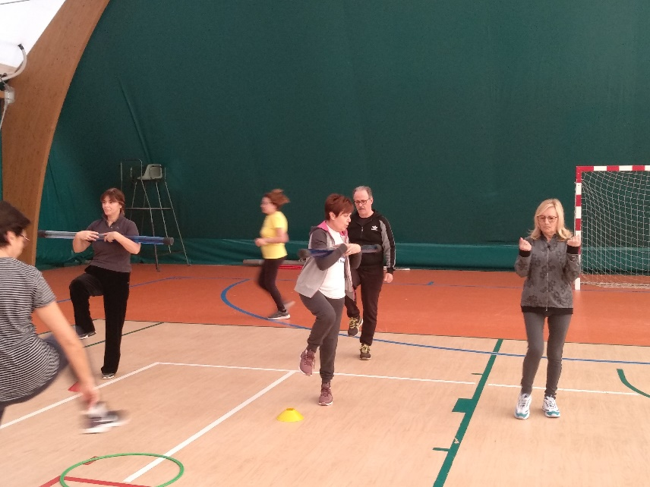
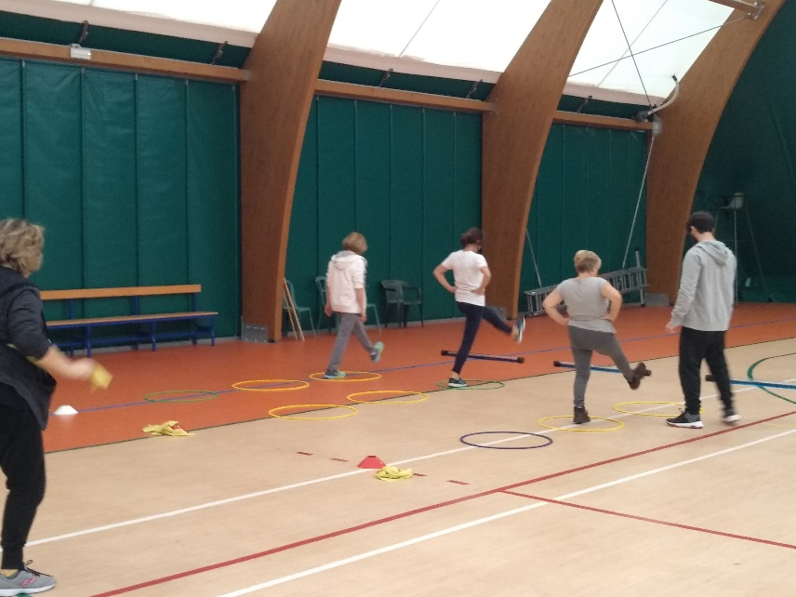
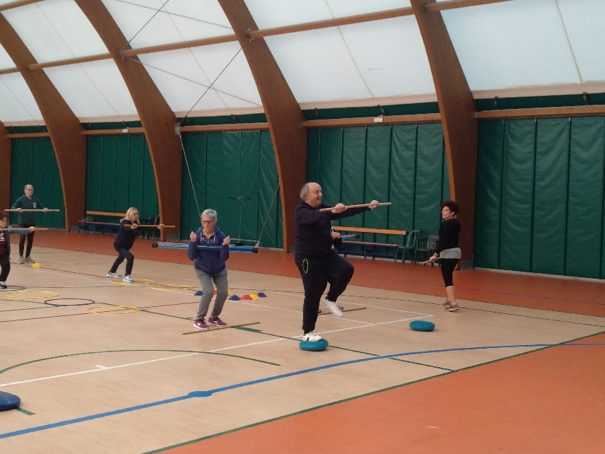
RESULTS
In the IG for right and left limb respectively, the SLST values showed a significant increase in support time equal to 26.5% and 16.2% (p<0.005). In the IG the 8-FUAGT values showed a significant time decrease equal to 27% (p<0.005). In both tests, the CG showed no significant changes.
IMPLICATIONS
The introduction of instability tools seems to involve a high stress on the static and dynamic balance abilities; the dynamic balance seems capable of positively influencing the walking speed in the over 65 years old

