Slide 1
Stakeholders’ Perceptions of PETE Students’ Knowledge of Motor Development
Jared Androzzi, PhD
Winthrop University, USA
& Adam Keath, PhD
Winthrop University, USA

Slide 2
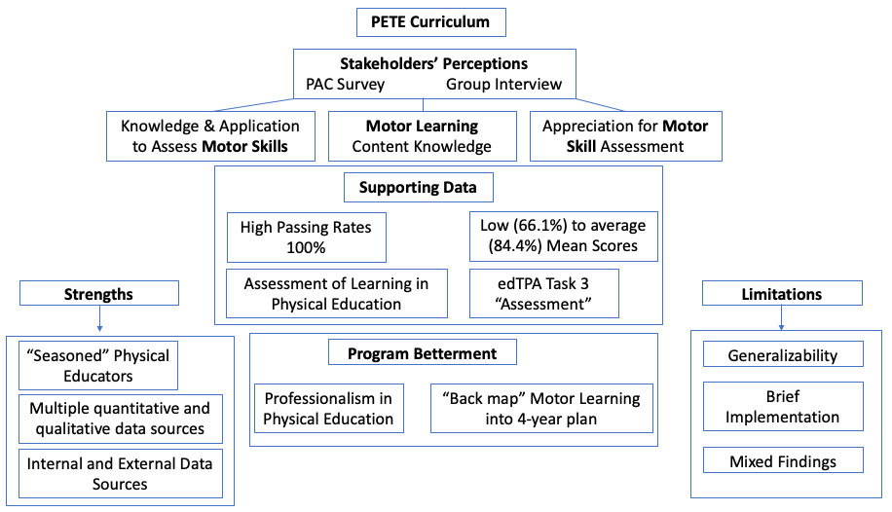
Purpose
Physical Education Teacher Education (PETE) programs are responsible for program betterment. Soliciting feedback from experienced professional practitioners in the field is a common method used to guide program direction. By serving as mentor teachers during students’ internships these practitioners have become valuable stakeholders of the program. The purpose of this study was to examine stakeholders’ perceptions of PETE teacher candidates’ (TCs) professional competencies, and to use the data to drive the curriculum update process.
Methods
The researchers of this study administered a mixed methods design to the Professional Advisory Council (PAC) of an accredited PETE program in the Southeast United States. The PAC consists of eight stakeholders, which are host and mentor teachers for TCs during practicums and internships, respectively. PETE faculty members developed a survey to identify the most common areas in need of improvement as perceived by the stakeholders and developed proposals for program revisions accordingly. A follow-up meeting was held with the PAC to discuss the survey findings and further solicit their recommendations for program development and to obtain their feedback on the PETE faculty members’ proposed program improvements.
Results
Conclusion con’d
The PAC survey results found that 13% of the stakeholders agreed that TCs need to improve their ability to “assess” motor skills, 13% agreed that TCs need to improve their understanding of “content”, and 25% felt that the TCs’ should display a greater appreciation for “assessment importance” of motor skills. All three of these skillsets are relevant to TCs’ knowledge of motor development. Additional findings demonstrated a perceived need for TCs’ to engage in professional development opportunities in addition to completing the standard four-year plan of study.
These include high passing rates on Task 3 of the edTPA (100%) and the PETE assessment content course, “Assessment in Physical Education” (100%), however mean scores (Content Knowledge= 66.1% & Student Assessment= 84.4%) on the Praxis II indicate a need for improvement. The generalizability of these mixed findings is limited, considering this case study investigated one group of stakeholders’ perceptions of a single (N=27) PETE program. Further research is needed to examine multiple institutions’ stakeholders’ perceptions of their respective PETE programs.
Conclusion
These findings indicate mixed perceptions of TCs’ competence in SHAPE America Initial PETE Standards 1.d, 1.e, 5.a, and 5.b, all of which are based on TCs’ knowledge, application, and assessment of motor learning principles. Actual assessments, rather than perceptions of these TCs’ motor learning and development competencies, also indicate mixed levels of competence.
2020 International Motor Development Research Consortium (Email: androzzij@Winthrop.edu)

Slide 3
Thank you!
Questions?
Jared Androzzi
androzzij@winthrop.edu
Adam Keath
keatha@Winthrop.edu

